Slide 1
Mini Project – WordPress WebApp
Conducting Functional Validation, GUI, API Testing

Slide 2







Technologies Used
XAMPP
Eclipse
Maven
Postman
TestNG
GitHub
XAMPP was used for hosting the AUT
Version 3.2.4
Eclipse was used to write and run the Java code
Version 2021-09 (4.21.0)
Used for Project and Dependency Management (POM)
Version 3.8.3
Used for API Testing
Version 9.0
Used for conducting GUI Tests and Report Generation
Version 7.4.0
For integration
Central repository for project and related documents
Version 2.34.0
Java
Selenium
Windows
Browser
Programming Language
Version 1.5 JRE
Automation Framework
Version 3.141.59
Operating System
Windows 10 Build 19042.1348
Chrome, MS Edge, Firefox

Slide 3
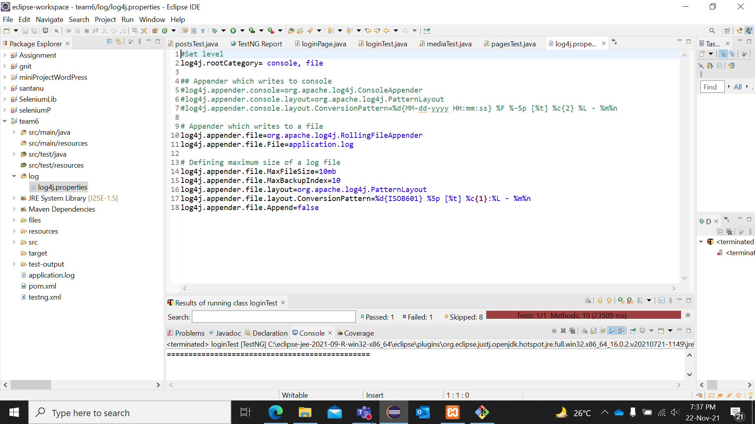
log4j.properties (Configuration File)

Slide 4
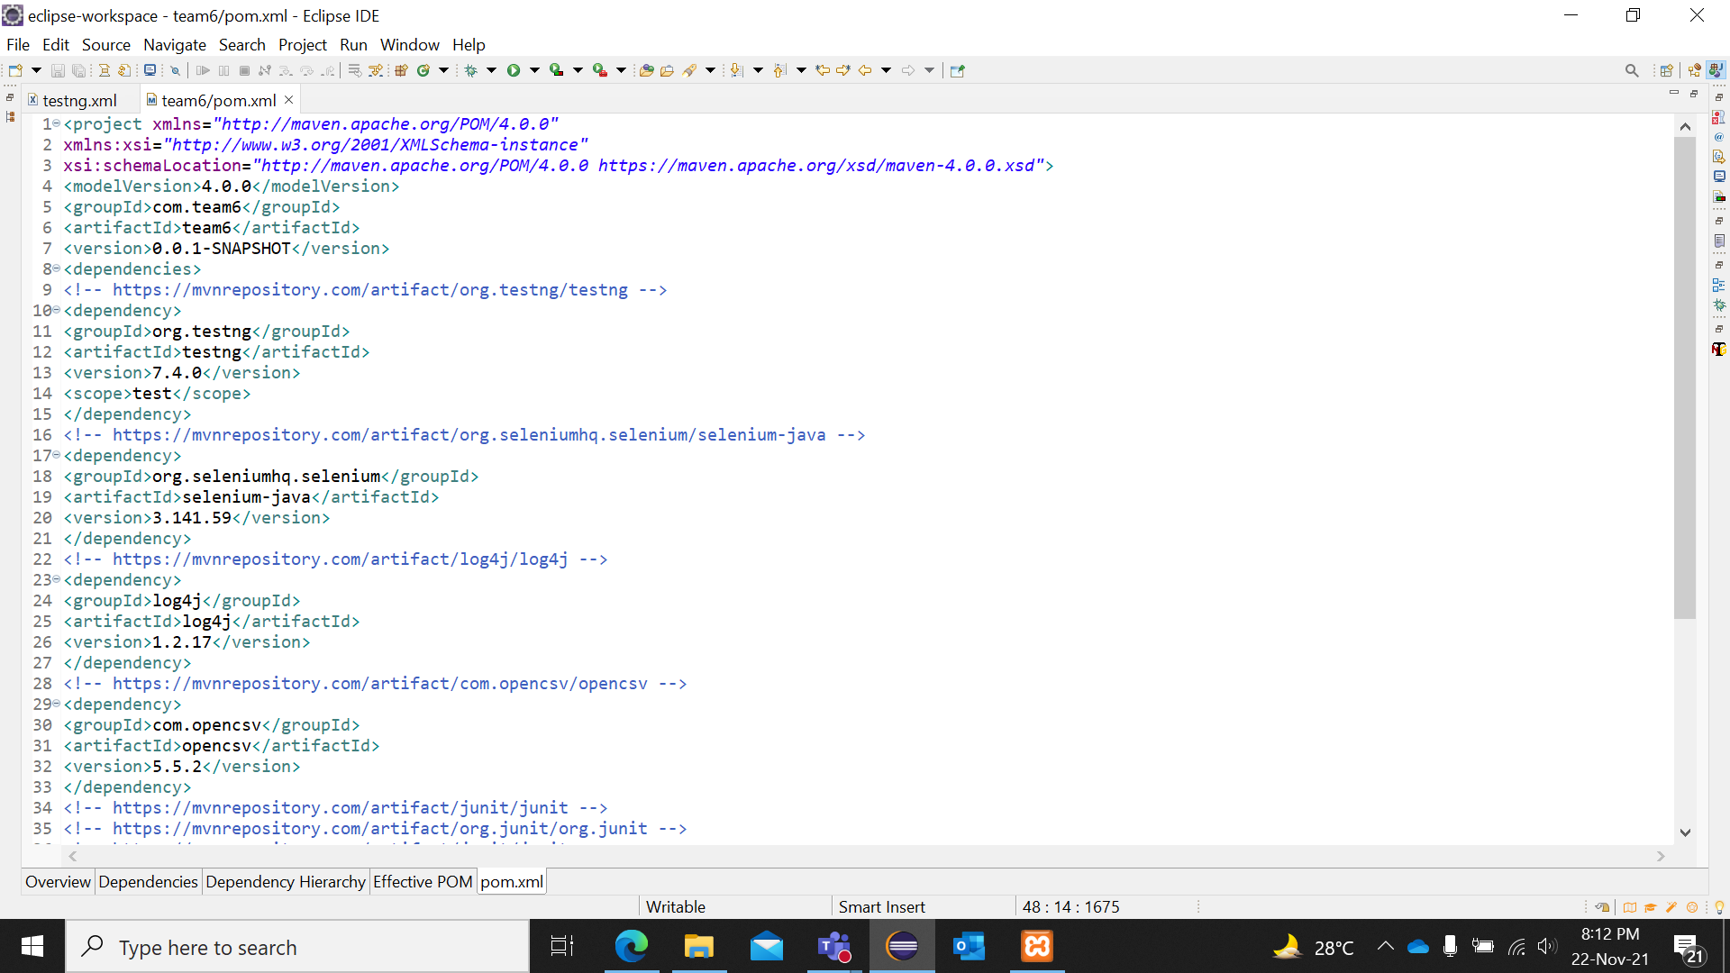
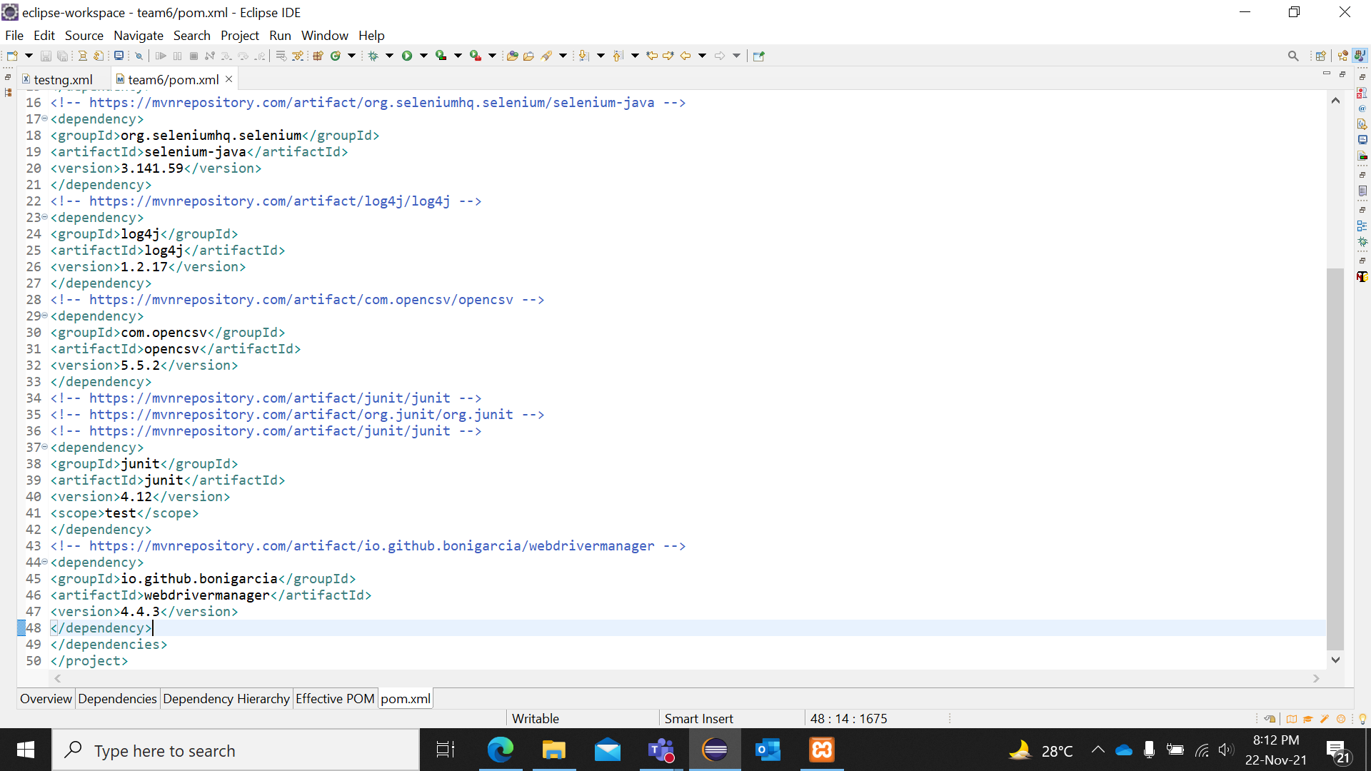
Maven pom.xml – Project Configuration File

Slide 5

About The AUT WORDPRESS v5.8
WordPress was originally designed as a blogging platform, and it continues to be well known for that. However, it has evolved into a fully fledged content management system (CMS) and, for some purposes, can even produce a solid web application – quickly, and at a significantly lower budget than custom development.
…
…
…
WordPress is a free and open-source content management system written in PHP and paired with a MySQL or MariaDB database.
WordPress is open source software you can use to create a beautiful website, blog, or app.
WordPress is free to download and use. However, to use WordPress on the web, you will need WordPress Hosting.

Slide 6
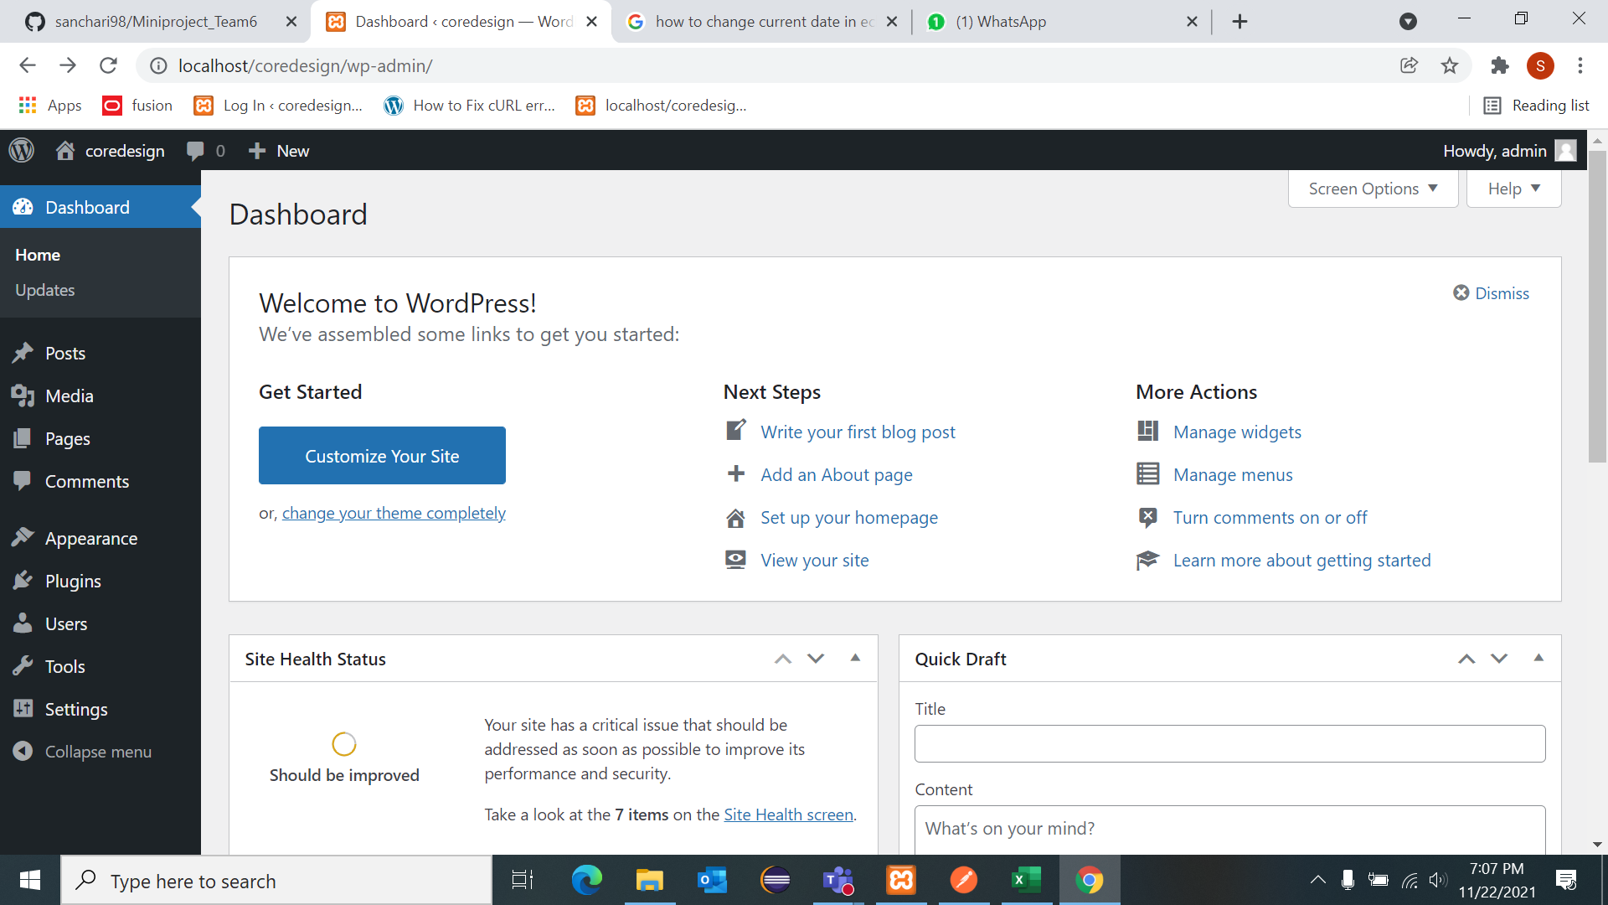
WordPress Dashboard

Slide 7





Objectives of Mini Project
Perform Functional Validation of the Website
On Modules such as Login, Posts, Media, and Pages
Validate Consistency & Adaptability
Verify website is consistent when it comes to colors, font types, etc. Manually
Performing Cross-Browser tests on the AUT
Perform UI Testing
Using TestNG to automate using Java-Selenium
Conducting Manual Tests whenever required
Conduct API Tests
Using Postman to test modules such as Pages, Posts, Media, Categories
Authorization, Correlation, Schema Validation
Document The Testing and Reporting
Using inbuilt Software and daily manual tracking of activity.

Slide 8
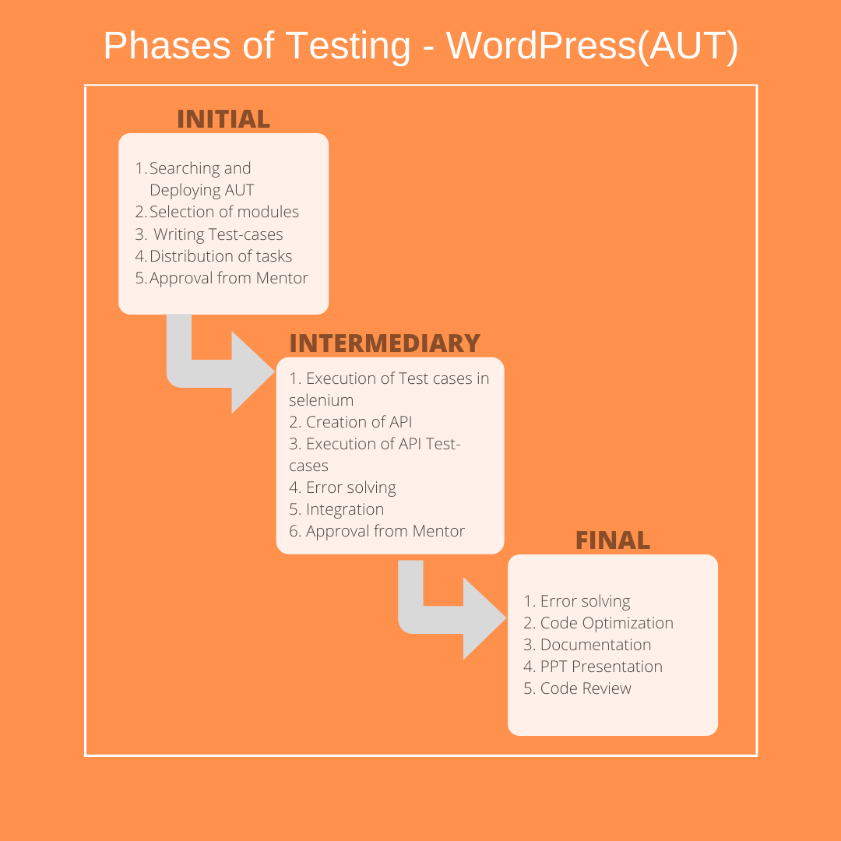

Slide 9












GUI Tests - Modules under Test
Login/Signup
Posts
Media
Register User(s) using phpMyAdmin for usage on local WebApp
Posts are essentially regular, yet time-specific pieces of content (such as news items). They're what you use to ensure your WordPress site is fresh, relevant, and interesting.
Media consists of the images, video, recordings, and files that you upload and use in your blog. Media is typically uploaded and inserted into the content when writing a Post or writing a Page.
Pages
Consistency
Cross - Browser Testing
WordPress pages are the standard built-in post type that allows you to publish content onto your WordPress blog
The page layouts and design elements should be consistent throughout a site so that it’s clear to the user that they are still on a site.
Conducting Cross-browser testing to confirm behavior of AUT under different devices, browsers, screen formats and sizes, and operating systems.

Slide 10

What we have done :
Identified 30 Test Cases from different modules of GUI.
Conducted feasibility study and segregated automatable/manual tests.
Conducted Manual and Automated Tests separately and maintained result document for both.
Picked up Test cases and automated using POM + DDT (using Excel) approach. Failed some test cases purposely, so that report shows combination of Test cases.
Read the input data required in the scripts from an excel(csv) file.
Prepared in-built mechanism to execute the scripts across different Browsers.
Generated Reports for GUI (TestNG) Tests.

Slide 11
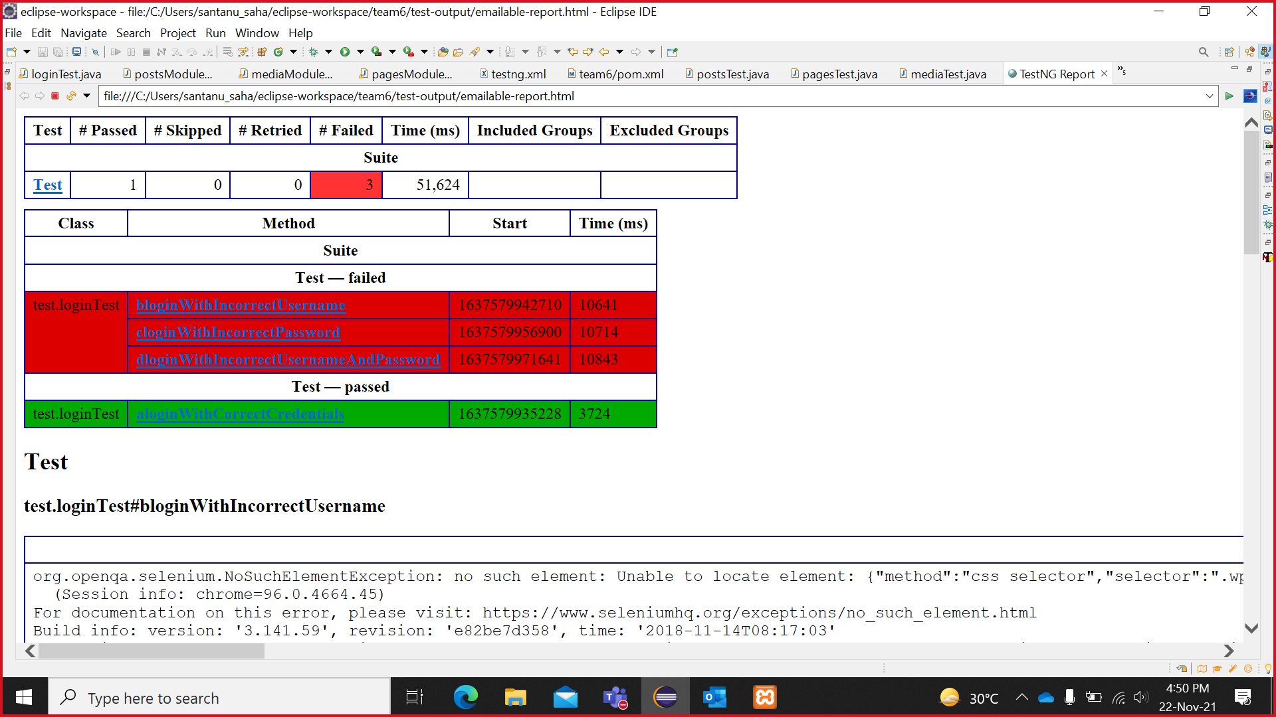
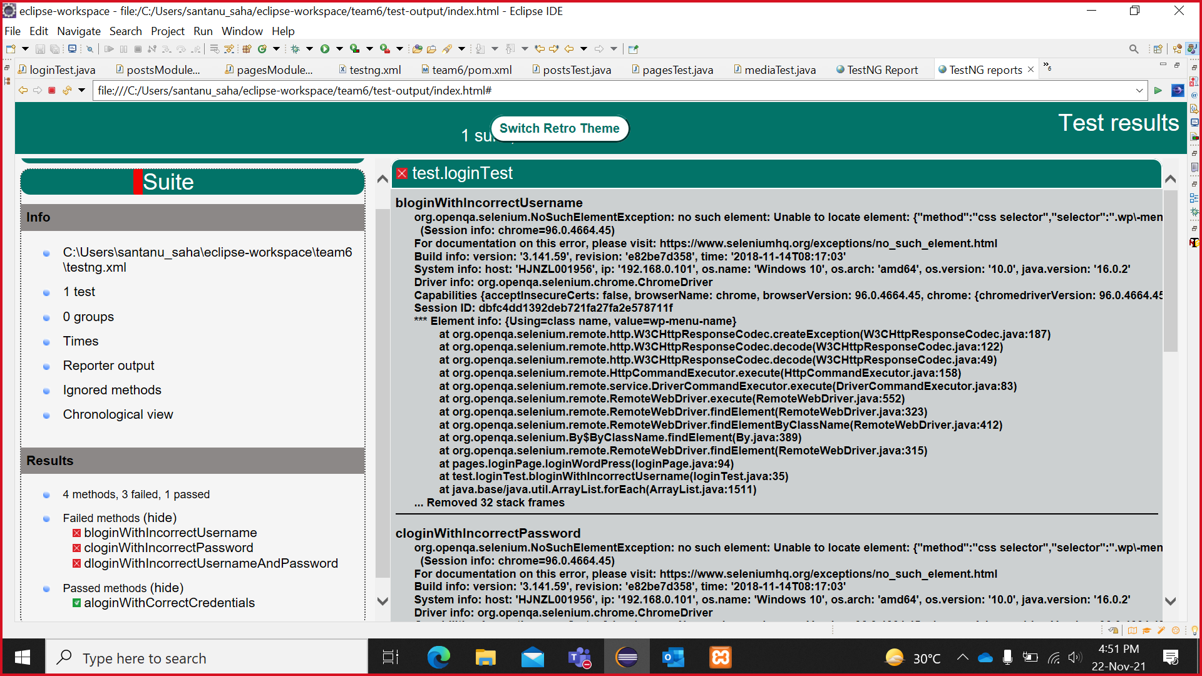
REPORT –
Login Module - loginTest(TestNG)

Slide 12
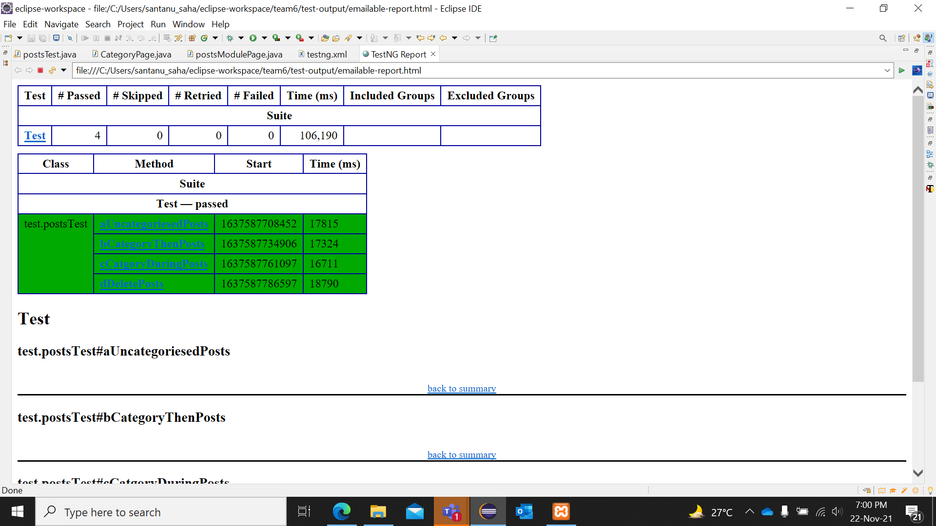
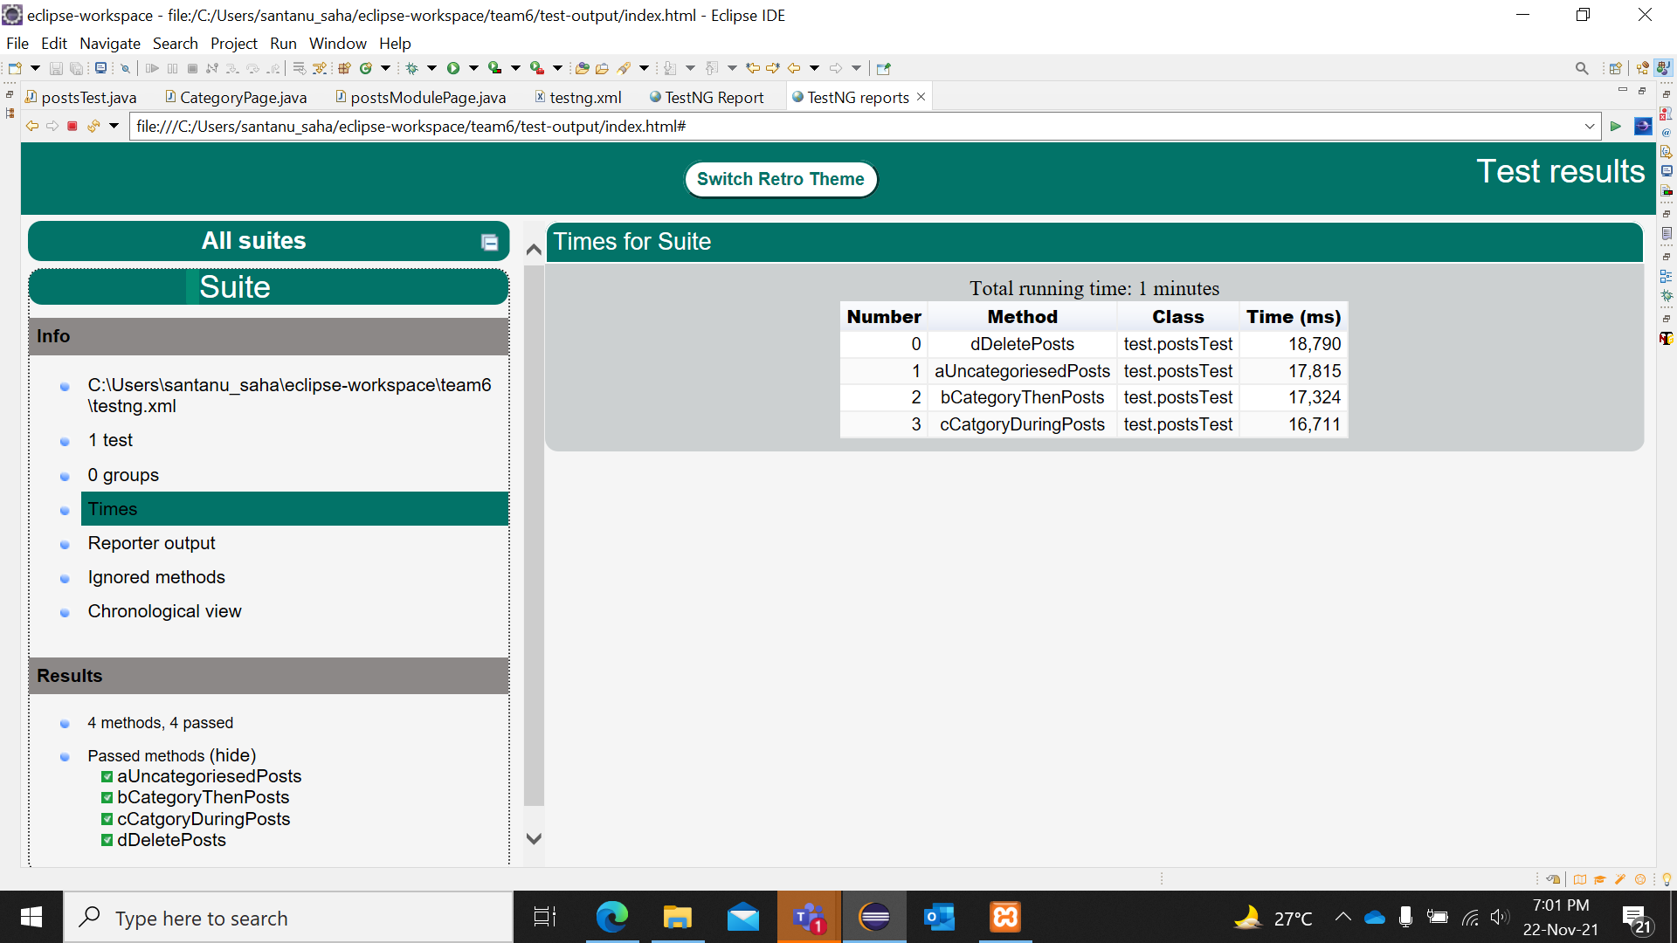
REPORT –
Posts Module - postsTest(TestNG)

Slide 13
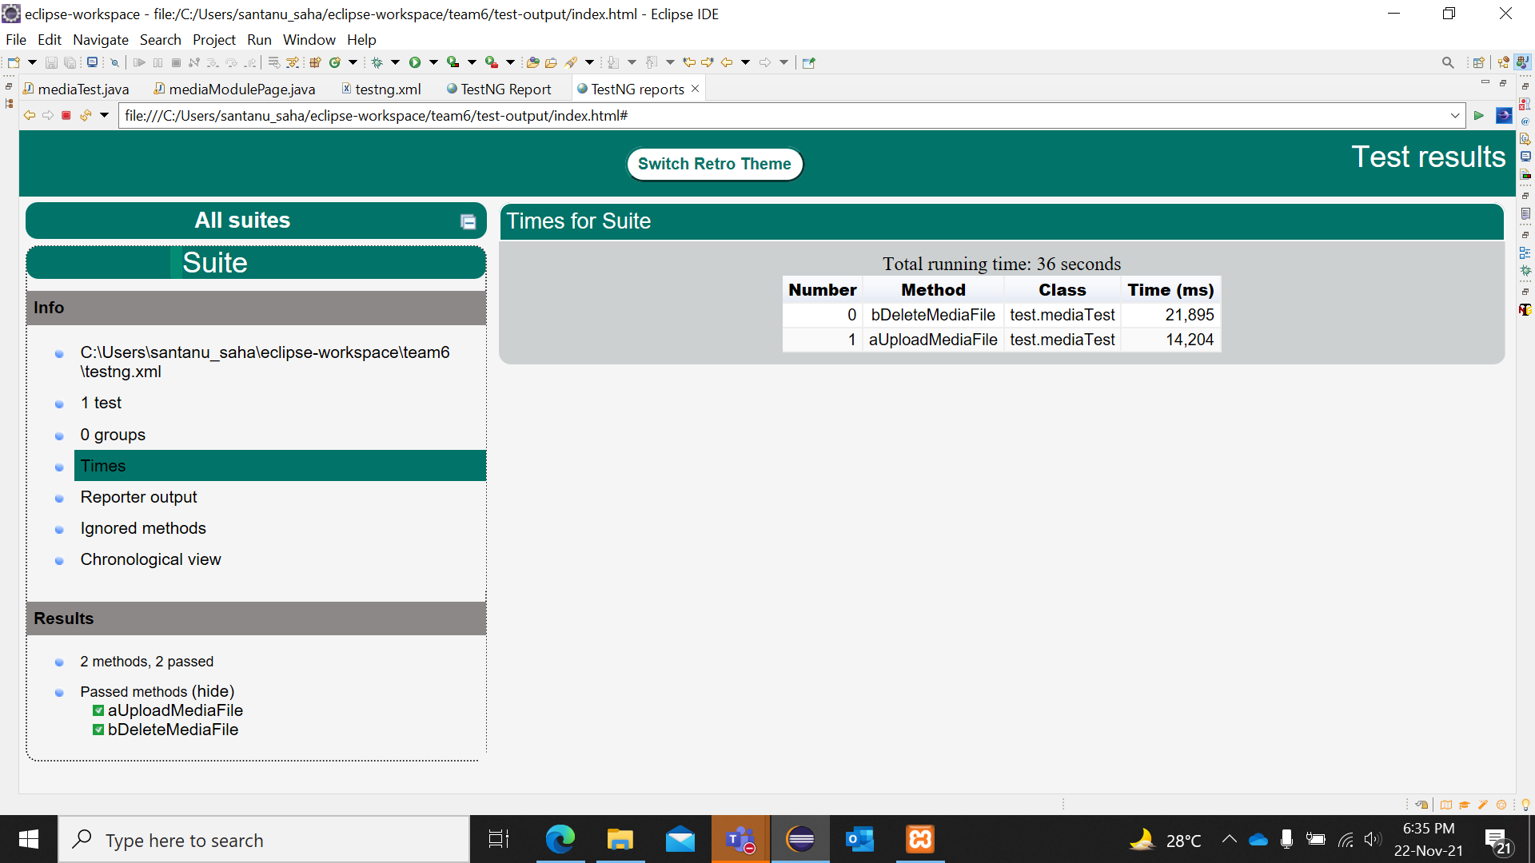
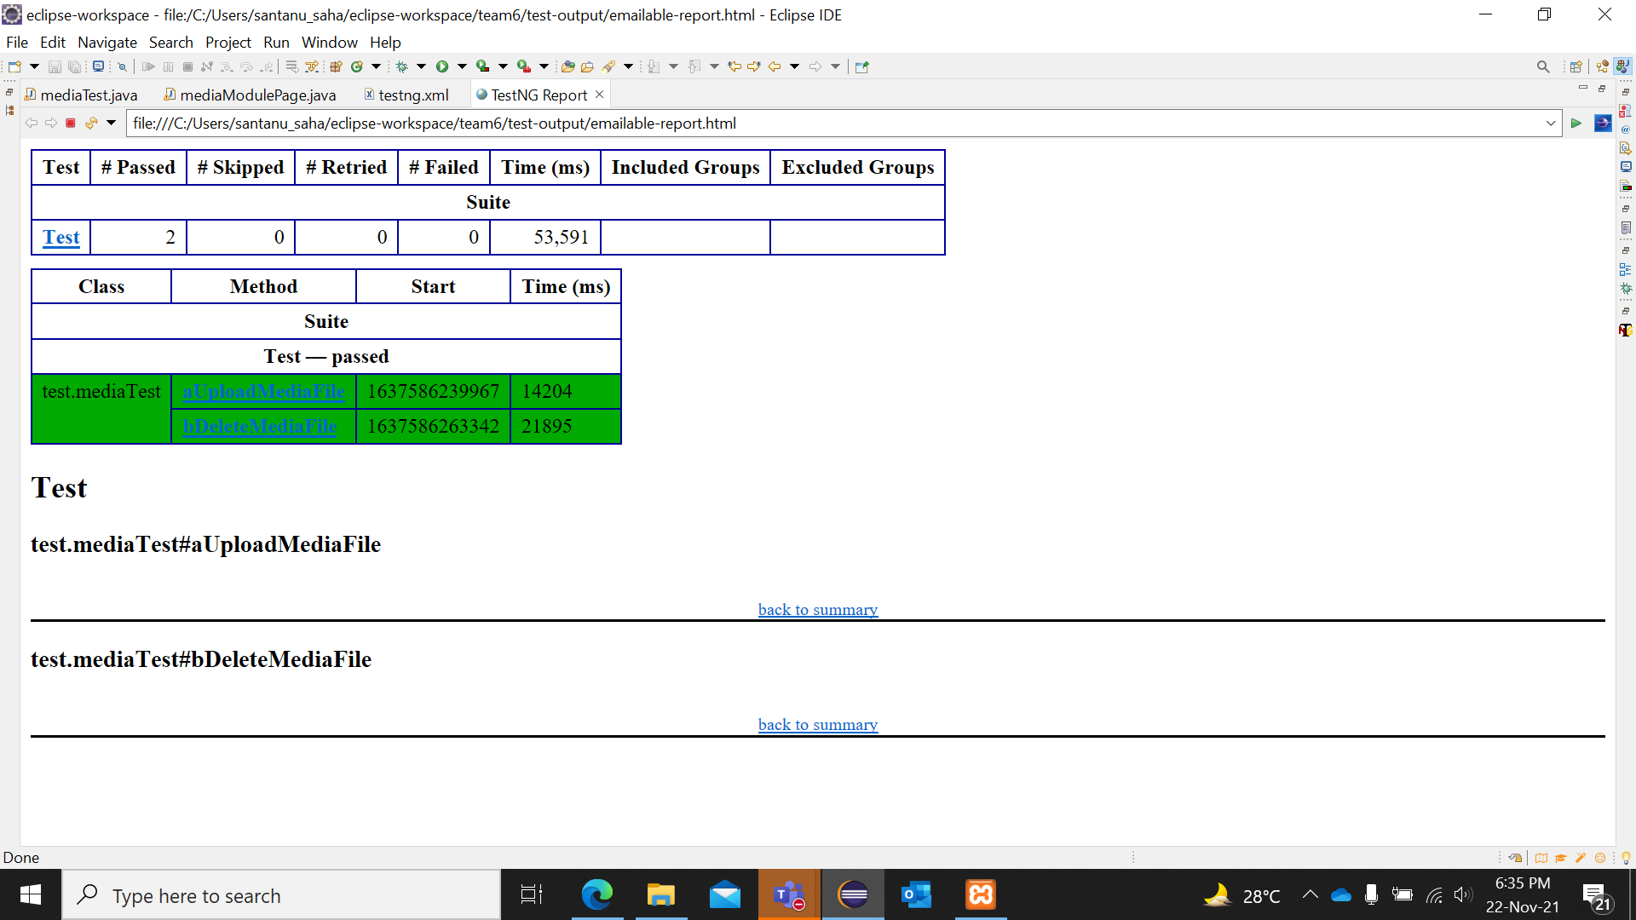
REPORT –
Media Module - mediaTest(TestNG)

Slide 14
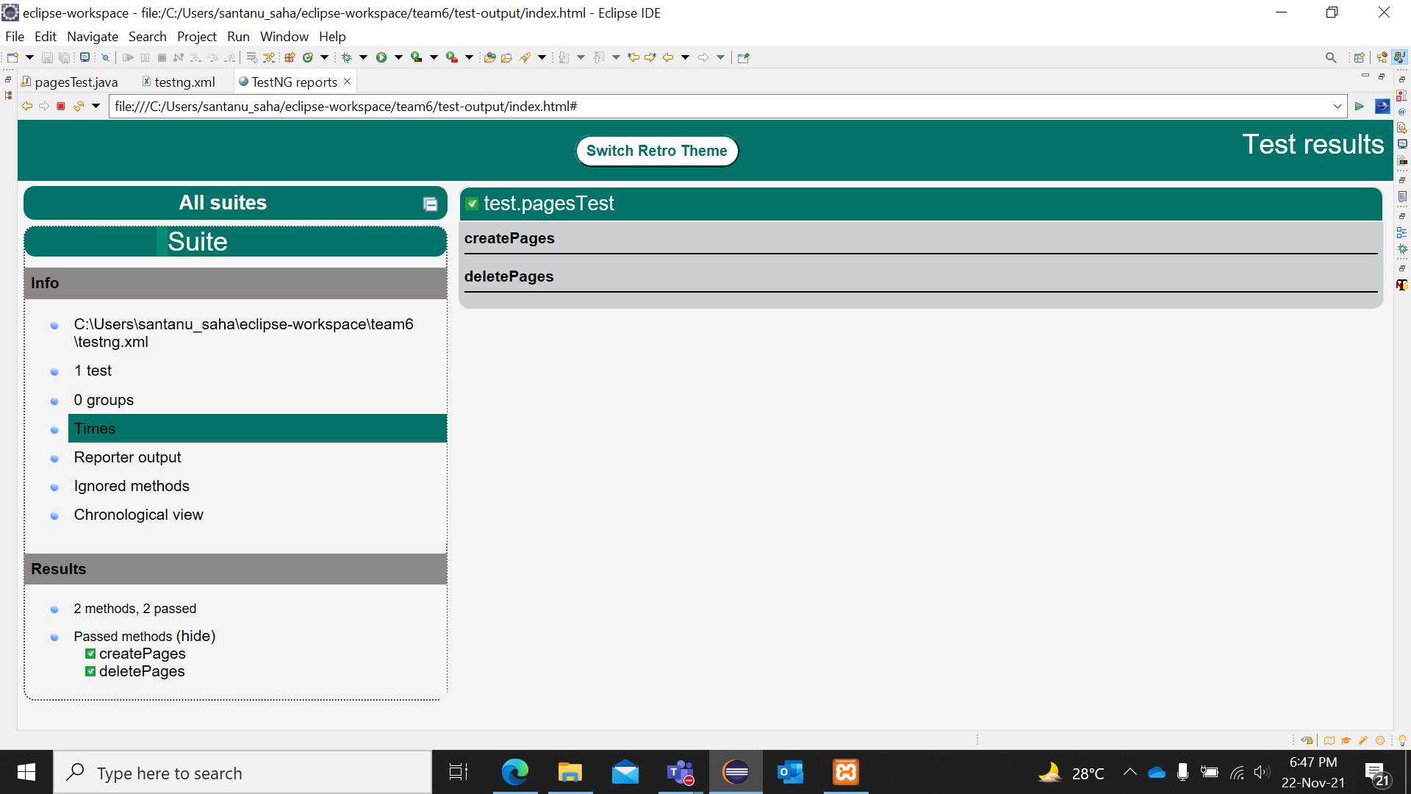
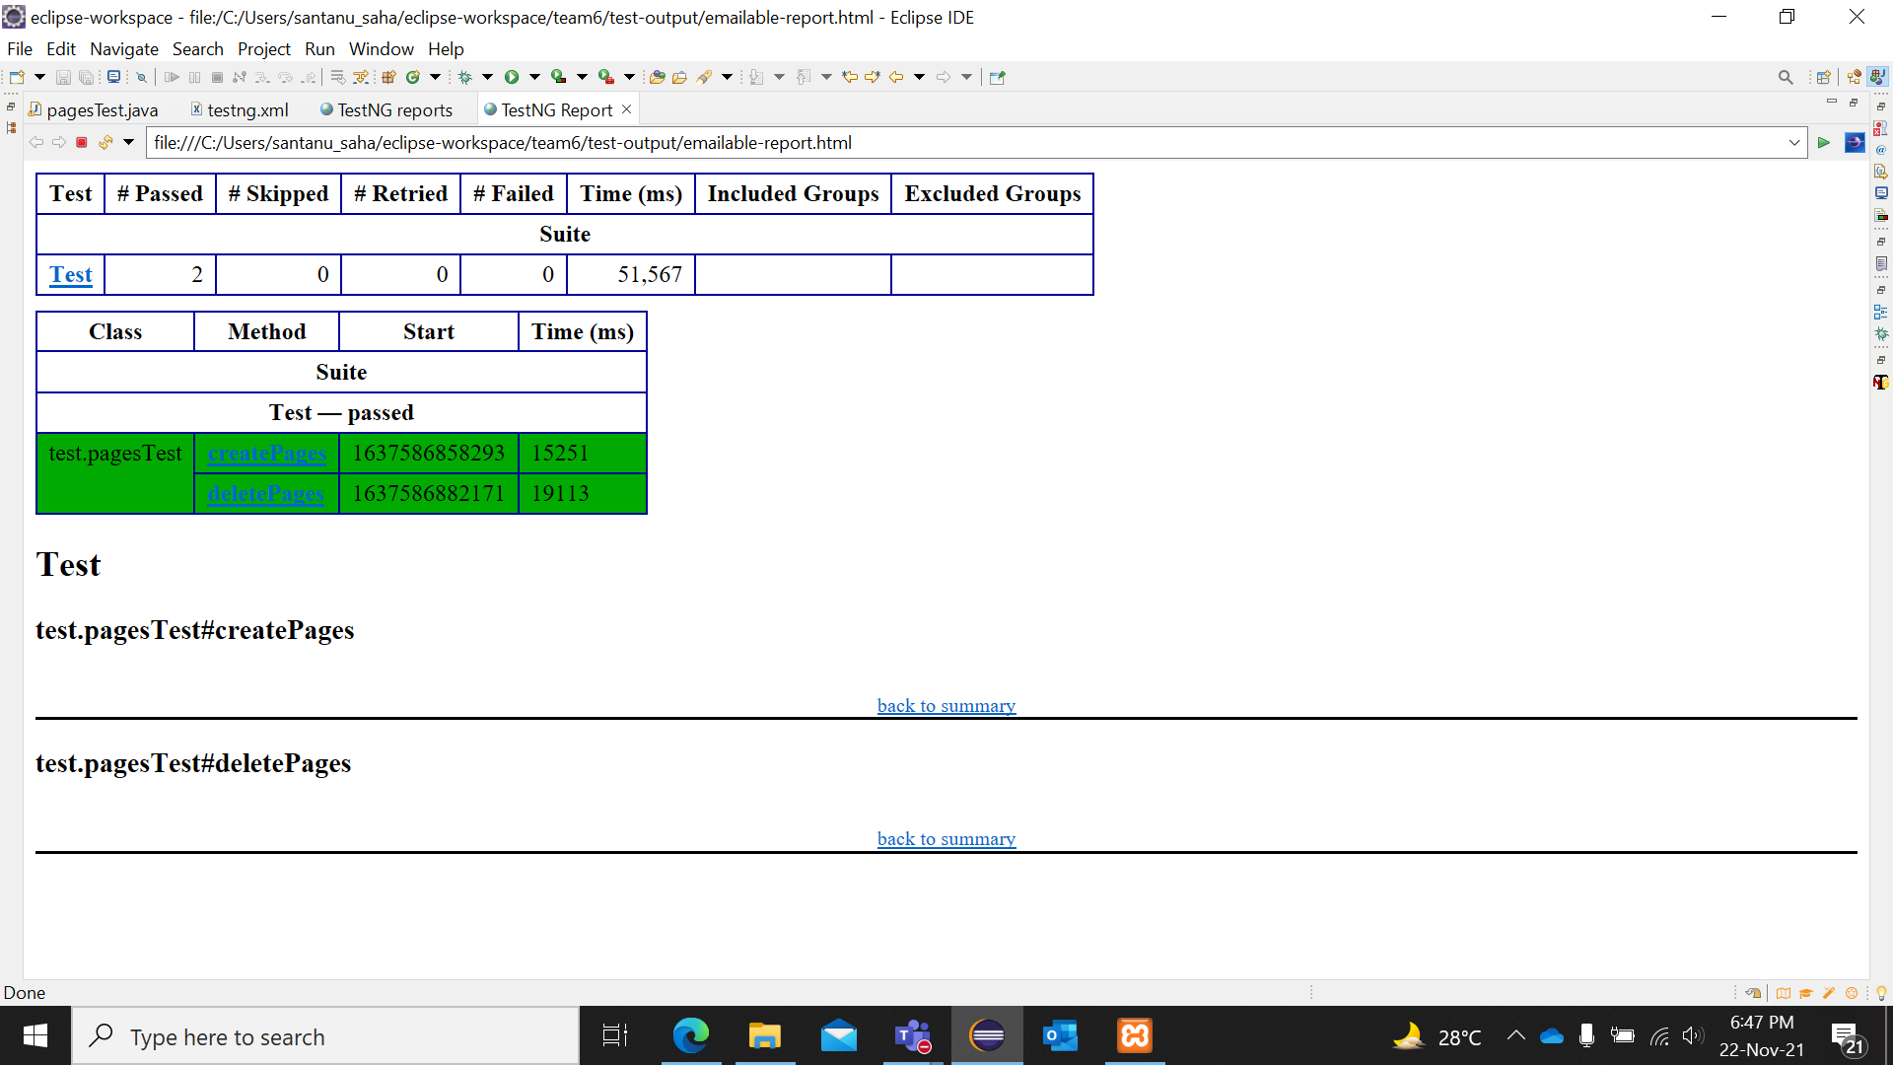
REPORT –
Pages Module - pagesTest(TestNG)

Slide 15
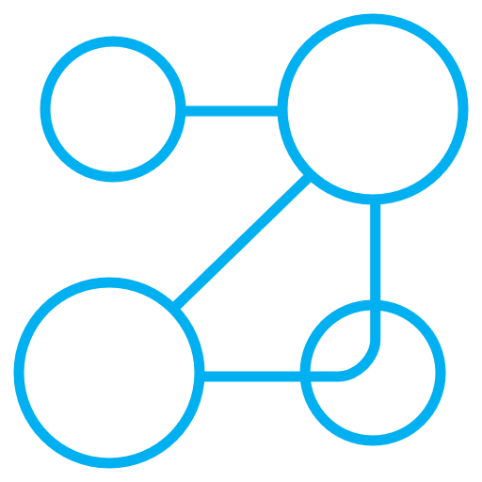




REST API Tests
API Features of AUT - WordPress
User authentication and authorization
Perform CRUD Operations
Identify at least 40 test cases for the API
Schema Validation
Implementing Global Variable & Environment Variable
Creating data , Retrieving data, Modifying data or Delete data. In REST, these operations are called as HTTP methods.
Test the APIs directly — from their functionality, reliability, performance, to security.
Automated tests make the API call, then validate the JSON response to match the expected schema.
Authentication refers to proving the correct identity. Authorization refers to allowing a certain action.
The key part in the key-value set in environment is called variable.

Slide 16

What we have done :
Explored API features of the AUT
Performed User authentication and authorization.
Identified 40+ test cases for the API
Performed CRUD Operations
API Schema Validation
Implementing Global Variable & Environment Variable
Maintaining And Logging Daily Activity

Slide 17
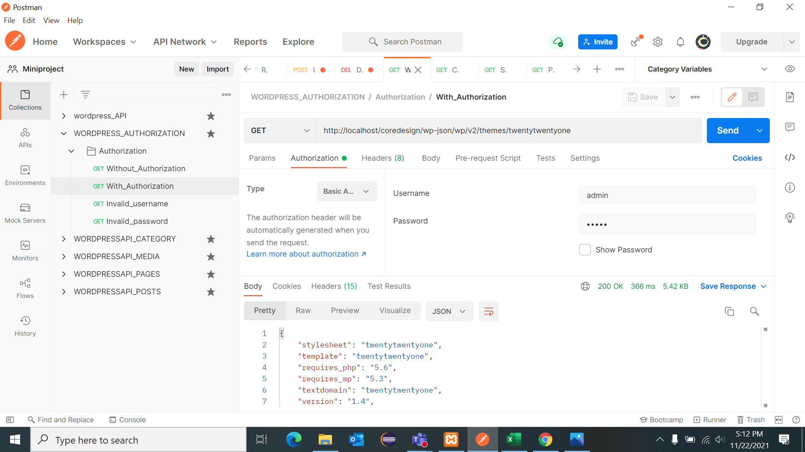
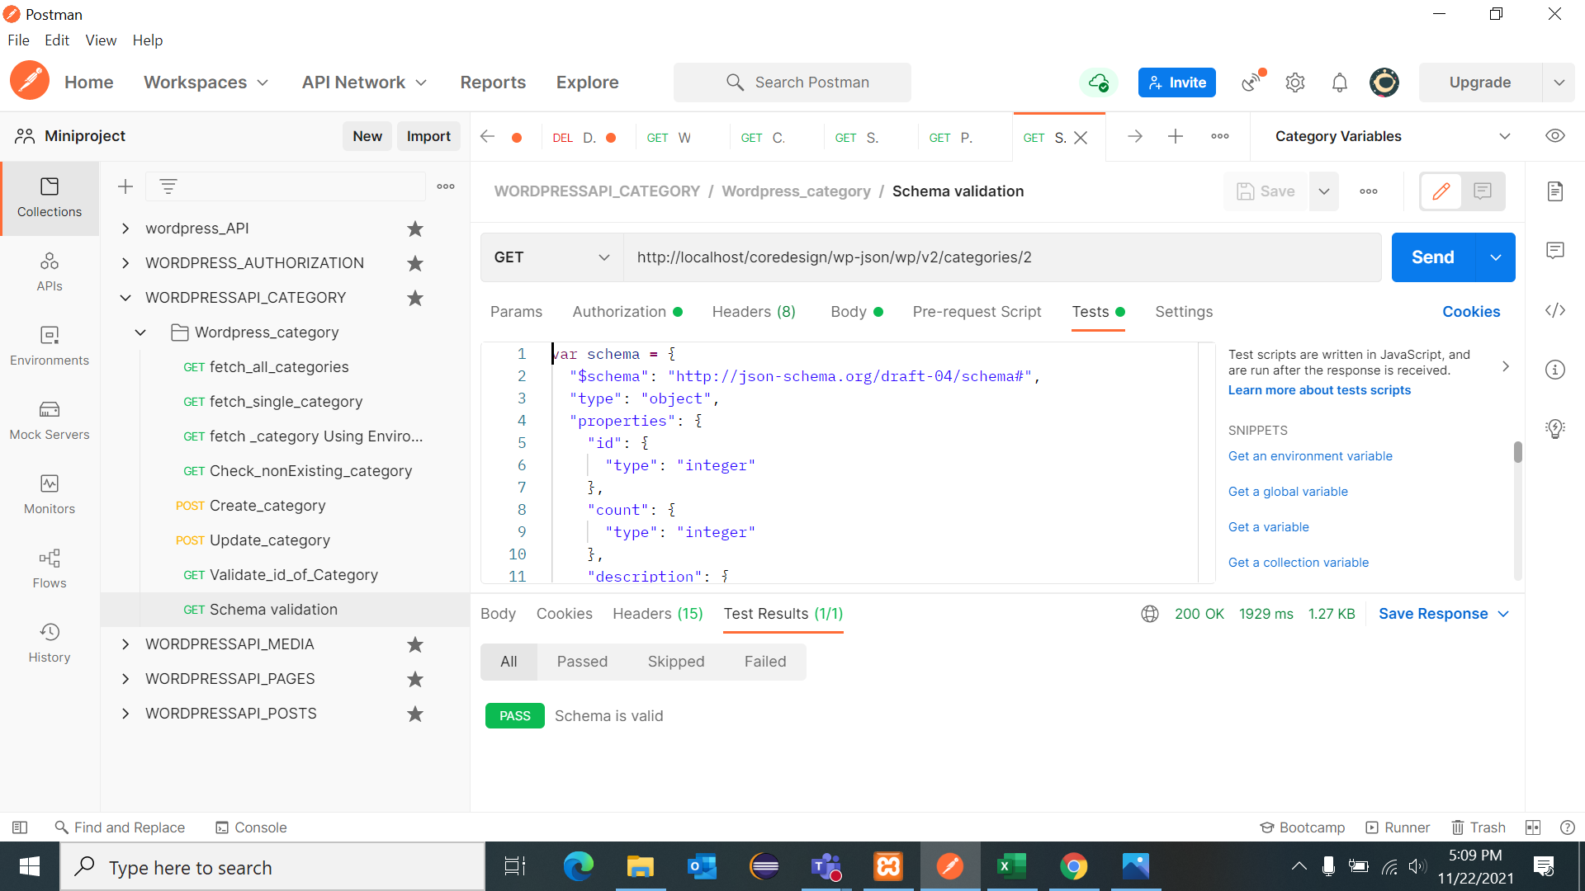
API – Posts->Categories Schema Validation
API - Login Authorization

Slide 18
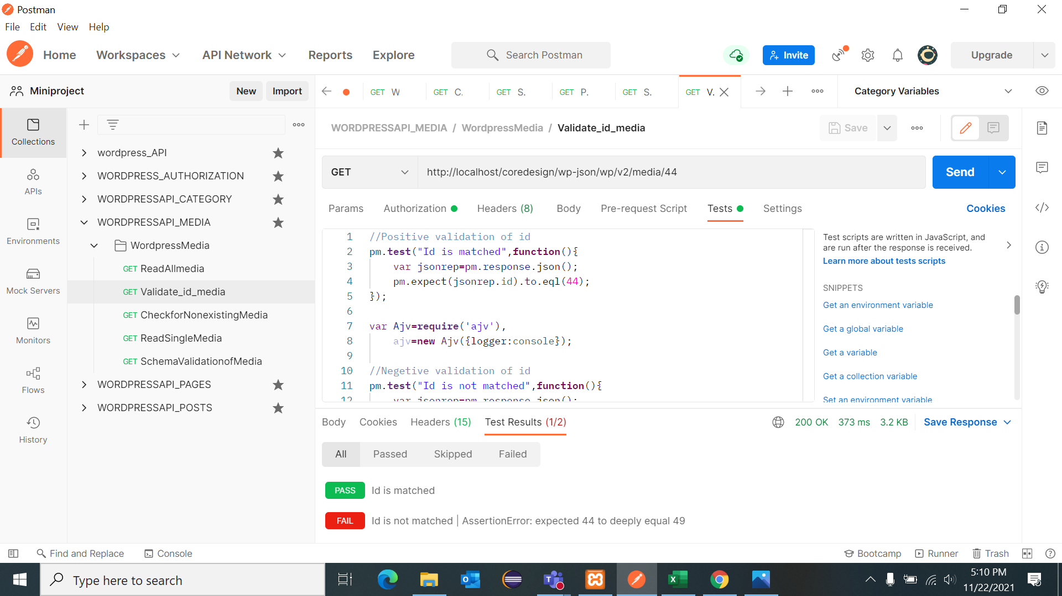
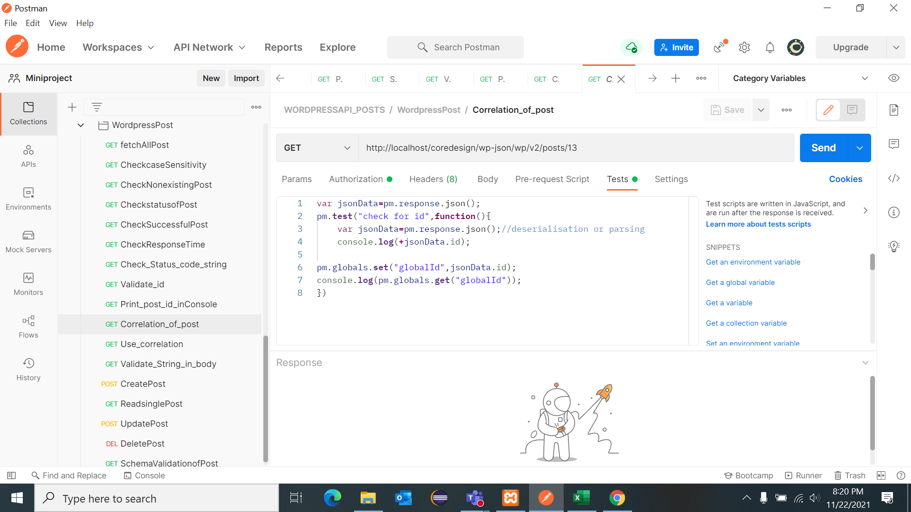
API – Correlation of Posts
API – ID Validation in Media

Slide 19

Application Under Test (AUT) : WordPress (Locally Installed)
Start Date : 13th Nov 2021
Code Freeze Date : 22nd Nov 2021
End Date : 24th Nov 2021
POC:
Sunit Bansal
Anuprita Nagpure
Siddhesh Zode
Omkar Jamdar
Team 06
Santanu Saha
Sanchari Saha
Samarjit Kundu
Kushal Ghosh
Brishti Mazumdar
Project Deliverable Location :
sanchari98/Miniproject_Team6 (github.com)

Slide 20


See Beyond, Rise Above

